Slide 1
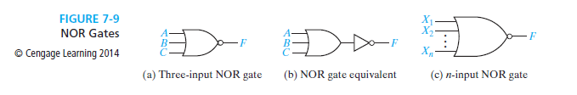
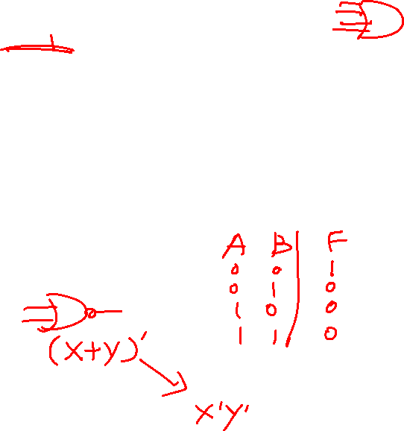
NOR Gates
NOR Gates:
A NOR Gate is shown above
The Truth Table
By applying DeMorgan’s Theorem, the NOR function can also be expressed as:

Slide 2
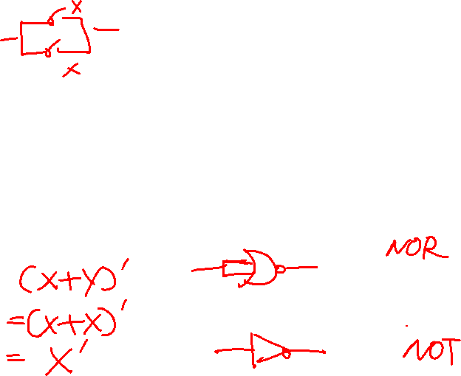
NOR Gates
Functionally Complete Operations and Gates:
NOR gate is also a universal gate, any switching function can be realized using only gates of NOR function.
NOR gate can be used to implement NOT, OR and AND gate.

Slide 3
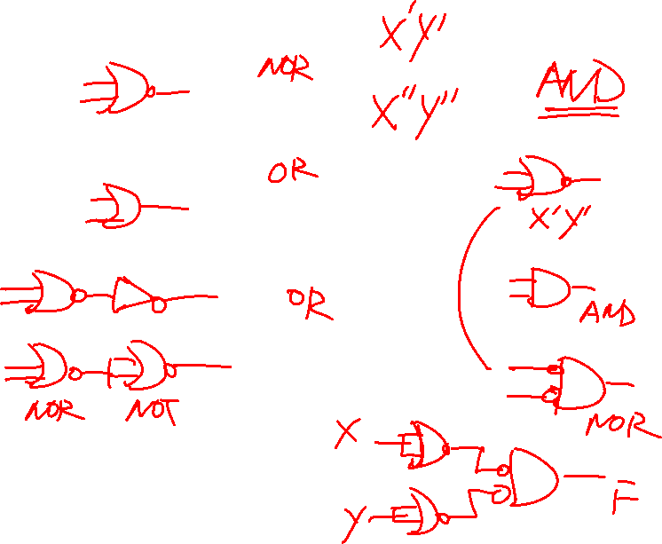

Slide 4
Lab 8. Universal gate NOR
4001 circuit: Quad 2-input NOR gate
14
13
12
11
10
9
8
Notch
1
2
3
4
5
6
7
Correct direction

Slide 5
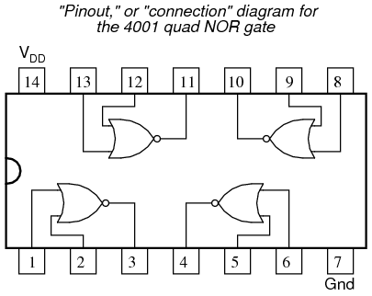
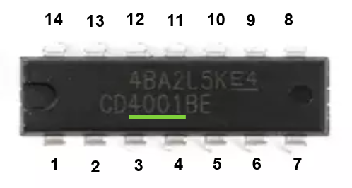
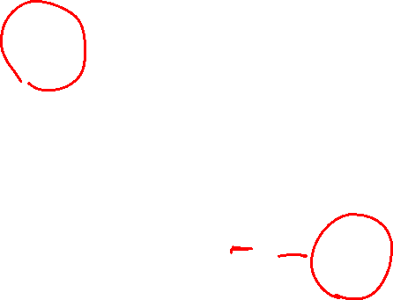
4001 circuit: Quad 2-input NOR gate

Slide 6
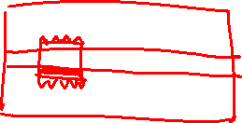
Lab 9. AND gate implementations
Insert the 4001 IC as the picture indicates. If not installed correctly, use tweezer to remove the IC, otherwise, the circuit may be damaged.
Don’t remove 4001 IC after completing today’s lab.

Slide 7
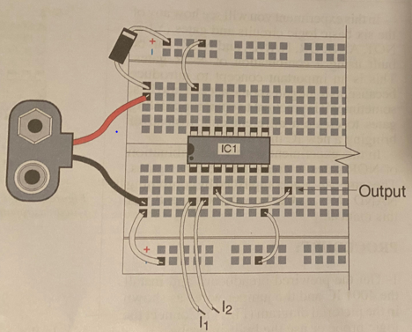
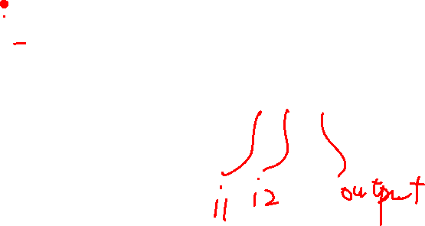
NOR gate

Slide 8
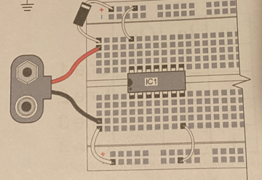
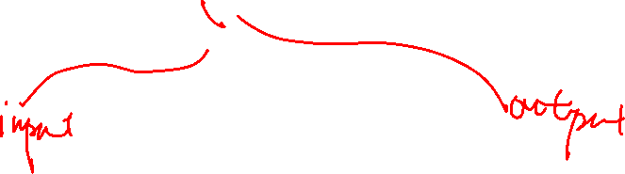
NOT gate
Make connections

Slide 9
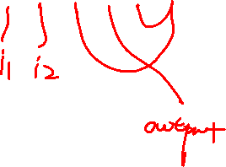
OR gate
Make connections

Slide 10
AND gate
Make connections

Slide 11
Bonus: NAND gate
Make connections

Slide 12
Lab 13. AND gate and NAND gate implementations
Sketch the connection either on slides or on a paper and let me check it.
Make the connections on the breadboard.
If you plan to do bonus questions, sketch connection and let me check, then make connection.

